Slide 1
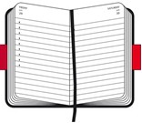


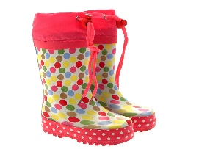
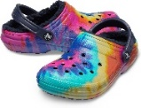
NEWSLETTER
Summer Term 2025
Key Dates:
Start of term – Tuesday 22nd April
School trip – Tuesday 13th May
Half Term – 26th – 30th May
Sports Day – Thursday 17th July
End of Term - Friday 18th July
Welcome to our new families joining Bright Sparks, hoping for lots of fun in the sun.
Staff Working Days: This can vary from time to time:
Days | Staff
Mon | Hannah Wiltshire, Christy Holmes, Linda Johnson, Kat Corbyn, Amanda Burke, Bethan Cox & Debbie Froud
Tues | Hannah Wiltshire, Christy Holmes, Linda Johnson, Bianca Dalessandro, Char Fry, Kat Corbyn, Bethan Cox & Debbie Froud
Wed | Hannah Wiltshire, Christy Holmes, Linda Johnson, Charlene Fry, Bianca Dalessandro, Bethan Cox & Debbie Froud
Thurs | Amanda Burke, Linda Johnson, Charlene Fry, Bianca Dalessandro, Bethan Cox, Hannah Wiltshire & Debbie Froud
Fri | Christy Holmes, Linda Johnson, Charlene Fry, Kat Corbyn, Amanda Burke, Bethan Cox & Debbie Froud
Reminders
Fees are due on first of every invoiced month to avoid confusion
Please chop grapes & olives lengthways in lunches to avoid choking
Don’t forget no chocolate or nuts including chocolate spread & peanut butter
Provide suitable clothing for the weather. Apply sun cream before drop off
Please relay messages to the staff member taking your child or email Debbie.
Please check emails for accident forms
Website
Keep up to date with our website
We are on Facebook, please check us out & write a review
Don’t forget to let us know any compliments, Complaints & Suggestions. We value your feedback.
If you feel your child would be interested in a certain topic please let us know for our future planning.
Please note our email address:
debbie.brightsparks@outlook.com
Please call 01276 677415
if your child cannot attend
Collect
Please collect flower petals.
Remember
Forest school
Ensure if your child has suitable clothing. Debbie will advise which children.
All Children wear boots/trainers to school and leave named Crocs at school.
Easter egg wrappers
Old baby bottles
Toilet rolls

